Slide 1
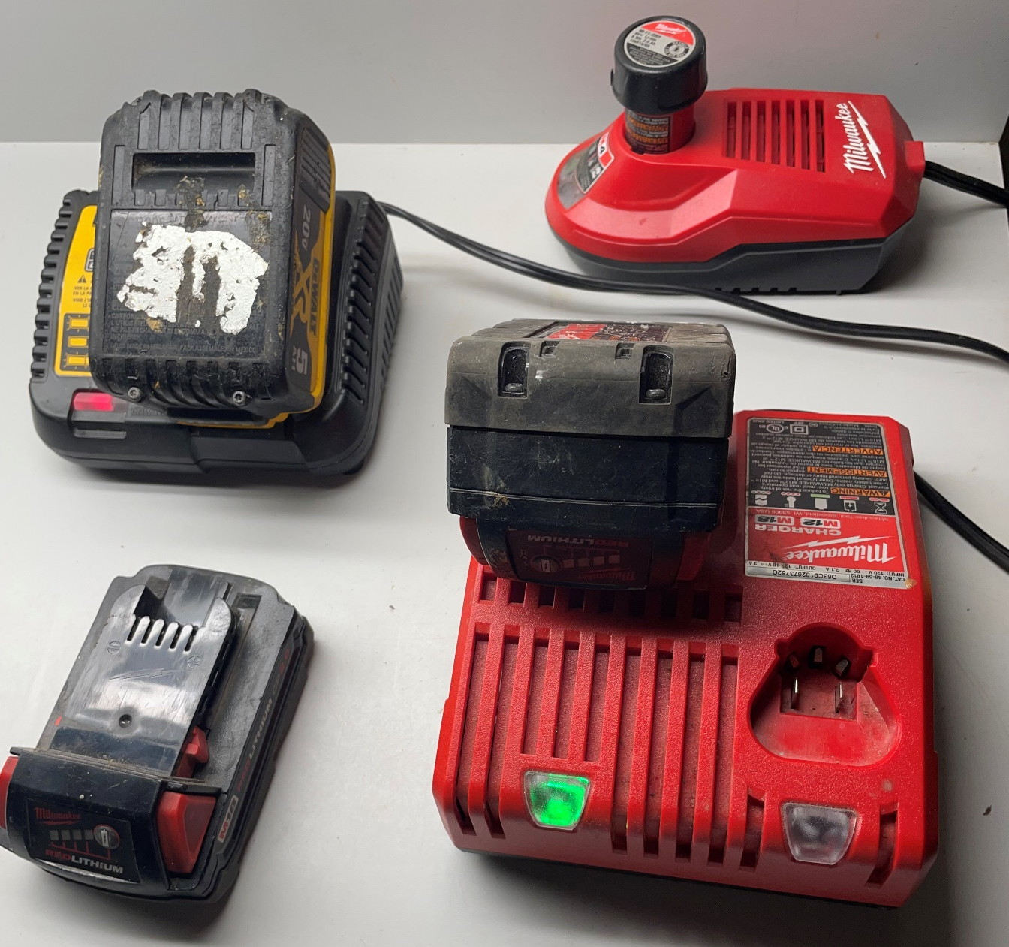
Lithium-ion Battery Risks Credible Information Resources
March 18, 2025
John_Weber@hsb.com
Principal Electrical Engineer, HSB

Slide 2
HSB Document ES995 Lithium-ion Batteries

Slide 3
Lithium-ion Battery Failures
Lithium-Ion Battery Failures

Slide 4
NFPA 800 Battery Safety Code Development
NFPA 800 Battery Safety Code Development

Slide 5
NFPA Lithium-Ion Article Resources
NFPA Articles on Lithium-Ion Battery Risks

Slide 6
Lithium-ion Battery Safety Sheet (NFPA)

Slide 7
Lithium-ion Battery Safety Recommendations

Slide 8
Lithium-ion Battery Safety Sheet (TUV)
TUV Recommendation

Slide 9
Handling Defective/Damaged Lithium-ion Batteries

Slide 10
Micromobility Safety

Slide 11
Micromobility Safety & NRTL Certification

Slide 12
NYC Micromobility Battery Safety Tips

