Slide 1
Sex, drugs, & alcohol
Handling Sin in Casualty Claims
Joshua J. Bovender, Esquire
Thomas, Thomas & Hafer
jbovender@tthlaw.com
717.237.7153
Kenneth Graham, Ph.D.
Forensic Toxicologist
grahamke1@verizon.net
610.322.2544

Slide 2
UNDERSTAND THE LAW UNDERSTAND THE SCIENCE CONSIDER SPECIFIC EXAMPLES Decipher what you can and cannot use
goals

Slide 3
Agenda
The Law
Examples of Claims
Introduction to Forensic Toxicology
Types of Samples
Alcohol & Other Drugs

Slide 4
COMMON ISSUES
Triaging New Claim
Suggestion of Intoxication
Claimant, Insured, Witness
Sources & Proof

Slide 5
THE LAW
Coughlin vs. Massaquoi (Pa. 2016)
Intoxicated pedestrian
4 Lane highway, nighttime
No prior witnesses
Autopsy - BAC 0.313
Expert Report

Slide 6
Coughlin (cont’d)
Philadelphia trial court properly admitted evidence
No bright line rule requiring corroborating evidence
BAC + Expert Opinion = Admissible
Made admitting intoxication easier

Slide 7
Coughlin’s progeny
Shaeffer’s Ultrabright Carpet Cleaning (Pa. Super. 2018)
Solo vs. Polit
(Pa. Super. 2017)

Slide 8
CLAIMS examples

Slide 9
“Not That Drunk” Argument
Franklin County
Alcohol, cocaine, marijuana
.097% BAC related back to 0.10%, “Not that drunk”
Other Comparative Aggravators
“Mixed Narcotics” theory

Slide 10
methamphetamines
Schuylkill County
Motorcycle vs. Tree
Methamphetamines, marijuana, cocaine
Physiological impacts theory – risk-taking behavior

Slide 11
Post-mortem SOURCES
Mifflin County
Cabin Fire
Smoke Detector Theory
0.129% BAC
Testimony of Girlfriend
Vitreous Fluid vs. Chest Cavity

Slide 12
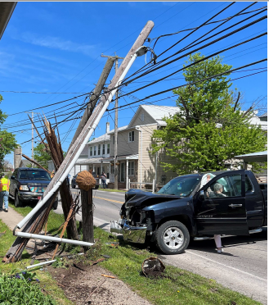
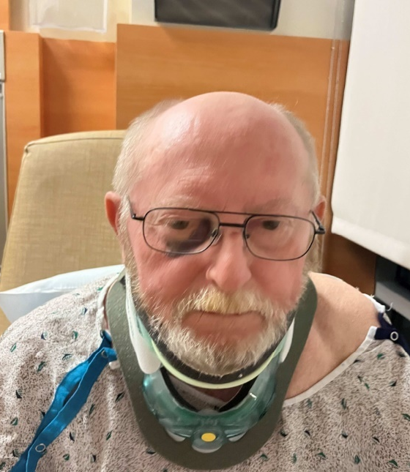
Close call
Auto collision
Probable liability
No suggestion of intoxication at scene

Slide 13
Close call (cont’d)

Slide 14
PRIOR Crimes
Crimen Falsi
Other Crimes
Perjury
Criminal Fraud
Criminal Trespass
Theft
Robbery
Forgery
Receiving Stolen Property
False Reports to Law Enforcement
False Identification
Burglary
Drug Convictions
Motor Vehicle Code
Violations
Assault
Battery
DUI
Licensure

Slide 15
introduction
Forensic toxicology

Slide 16
Forensic toxicology is a multidisciplinary field that combines the principals of toxicology with the disciplines of analytical chemistry, pharmacology and clinical chemistry to assist medical or legal investigations

Slide 17
ENCOMPASSES 3 DISCIPLINES:
Post-Mortem toxicology Analyzing biological specimens obtained at autopsy to identify the impact of drugs/alcohol/poisons in the persons death
Human performance toxicology examines the dose-response relationship between drugs present in the body and their effects. Forensic drug testing (fdt) Involves detecting drug use in contexts such as workplace, sport doping, drug-related probation and screening new job applicants.

Slide 18
Examples of claims

Slide 19
Types of claims
BUSINESS
Worker’s Compensation
Site injuries
Bars/Restaurants (Dram Shop)
AUTOMOBILE
HOMEOWNER

Slide 20
TYPES OF SAMPLES

Slide 21
BLOOD
ADVANTAGES
Allows interpretation of impairment
May provide information on dose and administration timing
DISADVANTAGES
Invasive collection process
Complex matrix
Generally, requires more sophisticated analysis techniques and instrumentation

Slide 22
urine
ADVANTAGES
Non-invasive collection process
Longer detection windows for drugs
DISADVANTAGES
Findings can only access exposure, not impairment
Many assays focused on non-active metabolites to extend detection period
Generally, requires more sophisticated analysis techniques and instrumentation

Slide 23
hair
ADVANTAGES
Non-invasive collection process
Allows for assessment of medium to long-term or high dosage substance abuse
Segmented analysis can provide information on when the substance was ingested
DISADVANTAGES
Findings can only access exposure, not impairment
Generally, requires more sophisticated analysis techniques and instrumentation
When tested, darker and coarser hair will have more drug than lighter hair

Slide 24
alcohol

Slide 25
ALCOHOL provides the desire, but takes away the performance
William Shakespeare
(Macbeth)

Slide 26
Alcoholic beverages
PROOF vs ALCOHOL CONTENT
100 % EtOH (v/v) = 200 Proof
40 % EtOH (v/v) = 80 Proof
DRINK EQUIVALENTS
12 oz Beer (5%) = 5 oz wine (12%) = 1.5 oz distilled spirits

Slide 27
Alcohol units of measure
BLOOD (also serum/plasma, urine, vitreous humor)
%, mg/dL, g/dL, g% and mg%
0.10% (w/v) = 100 mg/dL = 0.10 g/dL
BREATH
Mg/210L or g/210L

Slide 28
Alcohol metabolism
Metabolism Occurs Mostly in Liver
“Zero Order” Metabolism Kinetics
Averages 0.018 %/hr. (range = 0.014 to 0.024 %/hr.
Oro
Averages 18 mg/dL/hr. (range = 14 to 24 mg/dL/hr.
Practical View
Metabolic Rate ~ 1 Alcohol Equivalent Beverage per Hour

Slide 29
Alcohol concentration vs effects
ALCOHOL BLOOD CONC EFFECTS
0.01 to 0.05 % Slight physiological detectable on careful testing at 0.05%
0.05 to 0.0.07 % Euphoria, ↑ self-confidence, consistent Impairment of reaction responses and attention by 0.07%
0.07 to 0.10 % ↑ Impairment of reaction responses, attention, visual acuity, sensory motor coordination, and judgement. Individual may still appear sober
0.10 to 0.20 % ↑ sensory motor activities, reaction time, attention, visual acuity and judgement. Progressive increase in drowsiness, disorientation, emotional lability. By 0.20 %, loss of coordination, staggering gait, slurred speech apparent.
0.20 to 0.30 % Staggering, significantly impaired, may be lethargic and sleepy or hostile and aggressive. By 0.30 % many individuals fall asleep or pass-out
0.30 to 0.40 % Impaired consciousness, stupor leading to unconsciousness. Considered a medical emergency.
0.40 % or higher Unconsciousness, coma leading to death.

Slide 30
Visible Signs of intoxication
~ 0.150 % (150 mg/dL): Most non-drinkers or those with little tolerance will show signs of visible intoxication
~ 0.175 to 0.225 % (175 to 225 mg/dL): A majority (> 84 %) of individuals will show signs of visible intoxication, including chronic alcoholics.

Slide 31
Other drugs

Slide 32
Drug classes
STIMULANTS
Methamphetamine / amphetamine
Cocaine
OPIATE / OPIOID
Codeine
Morphine
Heroine
Oxycodone
Fentanyl

Slide 33
Drug classes
HALLUCINOGEN
Marijuana
PSYCHEDELICS
Phencyclidine (PCP)
LSD

Slide 34
Drug impairment interpretation
Non-linear metabolism vs alcohol
Non-linear effects at various concentration levels
Effects / impairment related to presence of “active” parent drug

Slide 35
THANK YOU

