Slide 1
Reinsurance Market Update
Steven Chirico, Director
September 18th, 2025
Pennsylvania Association of Mutual Insurance Companies (PAMIC)

Slide 2
Global Reinsurance Market – Discussion Outline
Outlook: Positive –
Sustainable Results for Longer
Robust Operating Results –
Despite Heightened Cat Activity, Casualty Challenges
Available Capital –
Internal Capital Generation, ILS Growth Continues
Potential Issues –
What Challenges Lie Ahead?
Expectations and Key Themes

Slide 3
    Outlook – Positive
    Sustainable Results for Longer

Slide 4
AM Best’s Market Segment Outlook – Global Reinsurance
Outlook
Revised to Positive
June 2024
Not just re-pricing but de-risking
Sustainable underwriting margins
Capital protection instead of earnings stabilisers
No capital depletion
Claims activity driven by secondary perils. Strong demand
Investor pressure behind underwriting discipline

Slide 5


AM Best’s Expectations – What AM Best Said Last Year
Underwriting profits –
slight reductions, but still strong
Inflationary pressures and interest rates –
Abating and declining, slowly
Rate movements –
modest declines in strong performing risks and higher levels of cover
Significant new capital /
number of new entrants –
unlikely
Retention levels –
minor movements into working layers
Increased use of Alternative Capital to flex capital needs

Slide 6
Global Reinsurance Market Outlook – Positive
Tailwinds
Although competitive conditions increased in property cat, pricing supports attractive margins
Reinsurers remained disciplined with terms and conditions and attachment points largely intact
Despite significant catastrophe and large man-made losses, segment set to report strong operating results
Segment remains well capitalized as evidenced by continued growth in dedicated capital
Demand for coverage remains strong
Life/Health reinsurance operations continue to act as a diversifying source of income and earnings
Interest rates remaining higher for longer
Headwinds
Elevated US casualty claims, reflecting the multi-year impact of social inflation, with adverse implications for underwriting and reserve margins
Increased frequency and severity of catastrophic loss activity, especially from secondary perils
Continued macroeconomic and geopolitical uncertainty

Slide 7
    Robust Operating Results –
    Despite Heightened Cat Activity, Casualty Challenges

Slide 8
Cost of Capital and Realignment of Risk
%
Reinsurers Meeting Cost of Capital
Profits
Improved technical profitability
Secular factors
Climate and geopolitical trends
Interest rates
Higher for longer
Outlook
Positive
Source: Bloomberg

Slide 9
Global Reinsurance Market Performance
Return on Equity (%)
Global Reinsurance Market –
Rolling Five-Year Average Return on Equity (%)
Five-Year Average
Year-End 2024, 10.0
Source: AM Best data and research
Notes:
ROEs: include primary, life, investments.
Price erosion, claims activity 17’, 18’.
18’/19’ u/r asset market movements (FI and equity holdings) / uw results just at breakeven
For example, National Indemnity – loss of 11.4bn in 18’ / gains of 47.7bn in 19’
5.7% average well below the approx. 7.5% WACC
Volatility of investments in 1H2020
In some extreme cases we saw companies losing up to 1/3 of their capital
Recovery in Q2: TINA effect / S&P500 driven by big tech
Not sustainable. Volatility to stay.
-----------------------------------------------------
Several elements here: u/w results, interest on fixed income, u/r capital gains.
2020 – u/r losses at the beginning, recovery towards the end of the year.
Companies cannot rely on investment results

Slide 10
Global Reinsurance Market Performance by Reinsurance Sector
US & Bermuda
European “Big Four”
Combined Ratio
Return on Equity
Lloyd’s
Asia Pacific
Notes:
Historical KPIs – USB/Europeans/Lloyd’s/AP
Highlight differences
IFRS17 challenges

Slide 11
Life Reinsurance – Mortality Trends
Raw number of deaths from all causes compared to projection based on previous years (United States)
Excess Mortality Estimates
March 2020 – December 2020 ~21%
January 2021 – December 2021 ~19%
January 2022 – December 2022 ~11%
January 2023 – December 2023 ~3%
January 2023 – December 2023 ~0.4%
Notes: The reported number of deaths might not count all deaths that occurred due to incomplete coverage and delays in reporting.
Sources: Human Mortality Database (2023), World Mortality Dataset (2023) from OurWorldinData.org,
RGA (Excess Mortality Rates)

Slide 12
Life Reinsurance – Adds Diversification but can be Volatile
Estimated Life Reinsurance Margin – European “Big Four” (2016-2024)
IFRS 17 Transition
– CSM release should support prospective profitability
Post COVID excess mortality
Notes: Company financial statements and annual results presentations. Life reinsurance margin estimated as profit over net premiums (or revenues under IFRS17). Includes investment income component.
Source: AM Best data and research

Slide 13
    Available Capital –
    Internal Capital Generation,
    ILS Growth Continues

Slide 14
Global Reinsurance – Capital Utilization
Estimated Dedicated Reinsurance Capital (USD billions)
P: Projected.
Sources: AM Best data and research, Guy Carpenter

Slide 15
A Hard Cycle With Excess Capital
Global Reinsurance – Capital Utilization (USD billions)
P: Projected.
Source: AM Best data and research
Notes:
Tolerance afforded to companies in extreme stress scenarios
Capital was never depleted from 2017 onwards
In 2022, utilization increased due to decline in available capital driven by unrealized losses
Improvement in utilization in 2023 as unrealized losses were recovered

Slide 16
ILS Trends
ILS Composition
(Approximated 2024)
144A Property Cat Bond Issuance by Quarter – 2017-2025 H1 (USD billions)
Collateralized Reinsurance
Catastrophe Bonds
ILWs
Sidecars
Sources: Artemis, AM Best data and research
Notes:
ILS market growth boosted by Cat Bonds
Record of about $17B already reached by 1H 2025 | $19B to $20B is within target for YE 2025
ILS Market Size:
ILS market was $107B in 2024 as estimated by GC/AM Best; 2025 ILS capital projected as
high as $115B in 2025
Segment Growth:
Slow growth in all other segments (collateralized reinsurance, sidecars, and ILWs) except
cat bonds
Record 2Q Issuance:
Record 2Q 2025 issuance of $10.4B vs. 2Q 2024 issuance of $8.2B
Outstanding Cat Bonds:
Total outstanding cat bonds currently over $52B: a 16% growth from the level at YE 2024

Slide 17
ILS Trends
Catastrophe Bond Loss Multiples – 2014-2025
Loss Multiple = Spread to Expected Loss
*Note: Spread and expected loss are dollar-weighted.
Sources: Artemis, AM Best data and research
Notes:
ILS market growth boosted by Cat Bonds
Record of about $17B already reached by 1H 2025 | $19B to $20B is within target for YE 2025
ILS Market Size:
ILS market was $107B in 2024 as estimated by GC/AM Best; 2025 ILS capital projected as
high as $115B in 2025
Segment Growth:
Slow growth in all other segments (collateralized reinsurance, sidecars, and ILWs) except
cat bonds
Record 2Q Issuance:
Record 2Q 2025 issuance of $10.4B vs. 2Q 2024 issuance of $8.2B
Outstanding Cat Bonds:
Total outstanding cat bonds currently over $52B: a 16% growth from the level at YE 2024

Slide 18
    Potential Issues –
    What Challenges Lie Ahead?

Slide 19
Near Term
Potential Concerns
What will the remainder of 2025 be like?
Macroeconomic and geopolitical issues
US casualty reserve challenges and
social inflation

Slide 20
AM Best’s Market Segment Outlook – Global Reinsurance
What might change our outlook,
and when?
Broad and significant rate reductions
Looser terms and conditions
Lower attachment points, into ‘working layers’
Expected RoE over cost of capital margin
Combination of the above

Slide 21
Longer Term
Challenges
Casualty reserving
Macroeconomic and geopolitical risks
Climate change
Artificial Intelligence
Cyber risks
Private credit

Slide 22
Longer Term
Opportunities
Ongoing capital efficiency through
capital markets
Addressing the protection gap
Changing demographics
Technology, Artificial Intelligence
Cyber and other ‘new’ markets

Slide 23
    Expectations and Key Themes

Slide 24
AM Best’s Expectations – The Next 12 Months
Operating results remain strong –
exceeding cost of capital
New capital –
internal generation / established players
Rate movements –
greater differentiation by cedent, layer,
and geography
Macroeconomic uncertainty remains
Retention levels –
discipline maintained
Alternative capital embedded in
capital structures

Slide 25
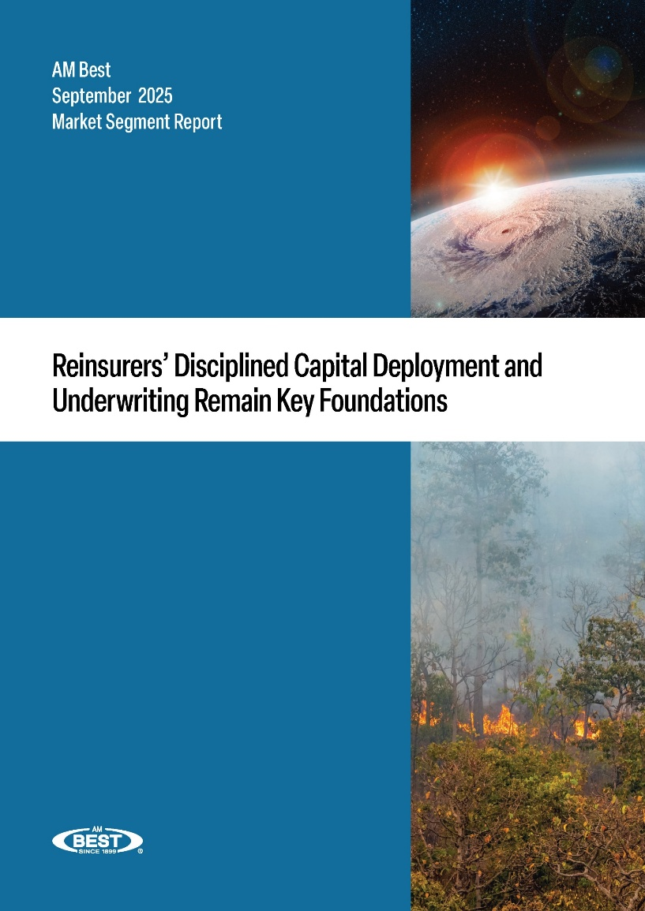
AM Best’s Key Themes – Monte Carlo Rendez-Vous 2025
Reinsurers remain disciplined
Payback to investors continues
Supply / demand equilibrium
Maintaining disciplined allocation
Positive outlook
Sustainable profitability

Slide 26
Q&A

Slide 27




AM Best’s Upcoming Events – Autumn 2025
November 4
AM Best’s
Insurance Market Briefing – SIRC
Marina Bay Sands Expo & Convention Centre, Singapore
November 6
AM Best’s
Europe Insurance Market &
Methodology Briefings – London
Convene 200 Aldersgate, St. Paul’s, London
November 25
AM Best’s
Insurance Market Briefing – MENA
Kempinski Central Avenue Dubai
Click on an event for more details and to register,
or visit AM Best’s events pages

Slide 29
Disclaimer
Copyright © 2025 by A.M. Best Company, Inc. and/or its affiliates (collectively, “AM Best”). All rights reserved. No part of this report or document may be distributed in any written, electronic, or other form or media, or stored in a database or retrieval system, without the prior written permission of AM BEST. For additional details, refer to our Terms of Use available at AM BEST’s website: www.ambest.com/terms. All information contained herein was obtained by AM BEST from sources believed by it to be accurate and reliable. Notwithstanding the foregoing, AM BEST does not make any representation or warranty, expressed or implied, as to the accuracy or completeness of the information contained herein, and all such information is provided on an “as is” and “as available” basis, without any warranties of any kind, either express or implied. Under no circumstances shall AM BEST have any liability to any person or entity for (a) any loss or damage of any kind, in whole or in part caused by, resulting from, or relating to, any error (negligent or otherwise) or other circumstance or contingency within or outside the control of AM BEST or any of its directors, officers, employees, or agents in connection with the procurement, collection, compilation, analysis, interpretation, communication, publication or delivery of any such information, or (b) any direct, indirect, special, consequential, compensatory, punitive or incidental damages whatsoever (including without limitation, personal injury, pain and suffering, emotional distress, loss of revenue, loss of present or prospective profits, loss of business or anticipated savings, or loss of goodwill) resulting from the use of, or inability to use, any such information, in each case, regardless of (i) whether AM BEST was advised in advance of the possibility of such damages, (ii) whether such damages were foreseeable, and (iii) the legal or equitable theory (contract, tort or otherwise) upon which the claim is based. The credit ratings, performance assessments, financial reporting analysis, projections, and any other observation, position or conclusion constituting part of the information contained herein are, and shall be construed solely as, statements of opinion and not statements of fact or recommendations to purchase, sell or hold any securities, insurance policies, contracts or any other financial obligations, nor do they individually or collectively address the suitability of any particular financial obligation for a specific purpose or purchaser. Credit risk is the risk that an entity may not meet its contractual, financial obligations as they come due. Service performance risk is the risk that an entity may not meet its contractual service performance obligations on behalf of its insurance partners. Consequently, neither credit ratings nor performance assessments address any other risk, including but not limited to, liquidity risk, market value risk or price volatility of rated securities. NO WARRANTY, EXPRESS OR IMPLIED, AS TO THE ACCURACY, TIMELINESS, COMPLETENESS, MERCHANTABILITY OR FITNESS FOR ANY PARTICULAR PURPOSE OF ANY SUCH RATING OR ASSESSMENT OR OTHER OPINION OR INFORMATION IS GIVEN OR MADE BY AM BEST IN ANY FORM OR MANNER WHATSOEVER. Each credit rating, performance assessment or other opinion must be weighed solely as one factor in any investment or purchasing decision made by or on behalf of any user of the information contained herein. Each such user will, with due care, make its own study and evaluation of each security or other financial obligation, and of each issuer and guarantor of, and each provider of credit support, and an independent view of service provider performance for, each security or other financial obligation that it may consider purchasing, holding, or selling or for each service contract that it may consider entering into. For additional detail on credit ratings or performance assessments, and their respective scales, usage, and limitations, refer to the Guide to Best’s Credit Ratings (http://www.ambest.com/ratings/index.html) or the Guide to Best’s Performance Assessments (https://www.ambest.com/ratings/assessmentMethodology.html).

Slide 30
Disclaimer
US Securities Laws explicitly prohibit the issuance or maintenance of a credit rating where a person involved in the sales or marketing of a product or service of the CRA also participates in determining or monitoring the credit rating, or developing or approving procedures or methodologies used for determining the credit rating.
No part of this presentation amounts to sales / marketing activity and AM Best’s Rating Division employees are prohibited from participating in commercial discussions.
Any queries of a commercial nature should be directed to AM Best’s Market Development function.

