Slide 1
Top 10 issues of 2024????
A look back and discussion of what may be ahead!
This Photo by Unknown Author is licensed under CC BY
This Photo by Unknown Author is licensed under CC BY-ND
This Photo by Unknown Author is licensed under CC BY

Slide 2
Notes:
We don’t want this to be boring!

Slide 3
GOOGLE GEMINI SAYS…….TOP 10 OF 2024
Climate change and natural disasters
Cybersecurity risks
Evolving regulations and compliance
Talent acquisition and retention
Technological disruption and AI/Insurtech
Economic uncertainty and shifting consumer expectations
Disintermediation and changing distribution channels
Global reinsurance market outlook
Pandemic preparedness
Focus on ESG (environmental, social & governance)

Slide 4
This Photo by Unknown Author is licensed under CC BY-SA-NC
This Photo by Unknown Author is licensed under CC BY-SA

Slide 5
Notes:
Thoughts on this quote?

Slide 6
This Photo by Unknown Author is licensed under CC BY
Notes:
Who sets boundaries when working from home?

Slide 7
Statistics from August 2024
91% of employees worldwide prefer to work fully or almost completely remotely.
14% of the US workforce (approximately 22 million adults) work from home.
In the US, 58% of white-collar workers prefer working remotely at least three days a week.
The technology industry has the highest percentage of remote workers, at 67.8%.
The global video conferencing market is projected to grow from $33.04 billion in 2024 to $60.17 billion by 2032.
In 2024, video conferencing software has already seen a market penetration of around 66%.
78% of remote employees say they are highly engaged compared to 72% working on-site.
Working from home can increase productivity by 13%, improve work satisfaction, and cut attrition rates by 50%.
Notes:
From Neat

Slide 8
Statistics from August 2024
With so many employees globally preferring to work remotely, this style of work is one that a huge number of people and businesses are embracing. According to a study by Quantum Workplace, 32% of employees prefer to work fully remotely, 41% prefer a hybrid work setup, and just 27% want to work full-time on-site.
In fact, remote work is so important to employees that 52% of men and 60% of women say they would rather quit than return to the office full-time. Additionally, 80% of women and 69% of men consider remote work one of the most important factors when searching for new employment opportunities. 98% of remote workers will also recommend this work style to others, and only 1% cite having a negative experience with it.
Notes:
From Neat

Slide 9
Who is working remotely in 2024???
With the tech industry having the highest number of employees working remotely $67.8%), it’s interestng to see how other industries stack up.
Statista’s 2023 statistics reveal that the agencies and consulting industry is second with 50.6%, followed by the finance and insurance industry with 48.7%. These industries are all well-suited to remote work, and they can easily rely on videoconferencing and online collaboration tools to complete tasks, connect with other workers and clients, and manage projects.
According to the U.S. Bureau of Labor Statistics, there are an abundance of teleworkers in professional and business services (67.4%), educational services (49%), and wholesale trade (39%). This also highlights the fact that remote work is more prevalent in certain industries as it is better suited.
When it comes to the age group of remote workers, Gen Zers and Millennials between the ages of 24 and 35 are most likely to work remotely. However, younger Gen Zers aged 20 to 24 are the least likely to apply for remote work.
If we look at gender, 38% of men work remotely full-time and 23% part-time, compared to 30% of women who work full-time and 22% part-time. This means that more men than women work remotely, which correlates with the employment-to-population ratio being higher for men globally.
Notes:
From Neat

Slide 10
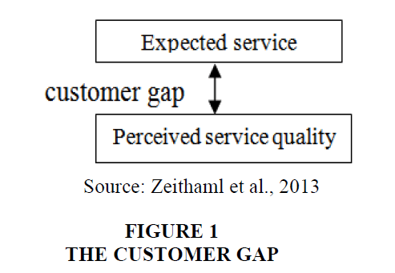
The ever shifting target…….
This Photo by Unknown Author is licensed under CC BY-SA
This Photo by Unknown Author is licensed under CC BY

Slide 12
Increased costs of products increases costs to insurance companies
Interest rates impact the profitability of insurers
Customers will price shop more frequently, show no carrier loyalty and have increased standards for satisfaction, whether product related or claim related
Demand for personalized products increases, resulting in a focus on improving customer experience and engagement
Increased digital channels available, removing the personal touch that once held value
Expectation by consumer of near immediate resolution
Direct link to talent acquisition and retention

