Slide 1
PAMIC Spring conference: What’s in store for 2025—The new political climate Matt Overturf, assistant Vice President – state affairs, Ohio Valley

Slide 2
NAMIC Membership
1,300+
6 of Top 10
$383B
NAMIC
Member Companies
U.S. P/C Companies Among Membership
Represented in Annual Premiums
48%
61%
25%
Of the U.S. Auto Insurance Market
Of the U.S. Home Insurance Market
Of the U.S. Business Insurance Market
Notes:
For more than 250 years, mutual insurance companies have been – and still are – about people coming together to protect themselves in a common need. Because there are no stockholders in a mutual insurance company, the interests of the policyholders are served first.
For more than 120 years NAMIC has been serving in the best interests of mutual insurance companies – large and small – across the United States as well as in Canada.
We strengthen and support our members and the mutual property/casualty insurance industry by leadership in advocacy, public policy, public affairs, and member services.
Through its advocacy programs NAMIC promotes public policy solutions that benefit member companies and the policyholders they serve and fosters greater understanding and recognition of the unique alignment of interests between management and policyholders of mutual companies.
NAMIC membership reflects many of the country’s largest national insurers as well as regional and local mutual insurance companies on main streets across America.

Slide 3
Namic overview
NAMIC Profile
$55 million in revenue, including affiliates and the association’s insurance company, NAMICO
25 advocates and policy experts in Washington D.C. and across U.S.
Largest insurance company trade PAC in America -- $1.3M per election cycle

Slide 4
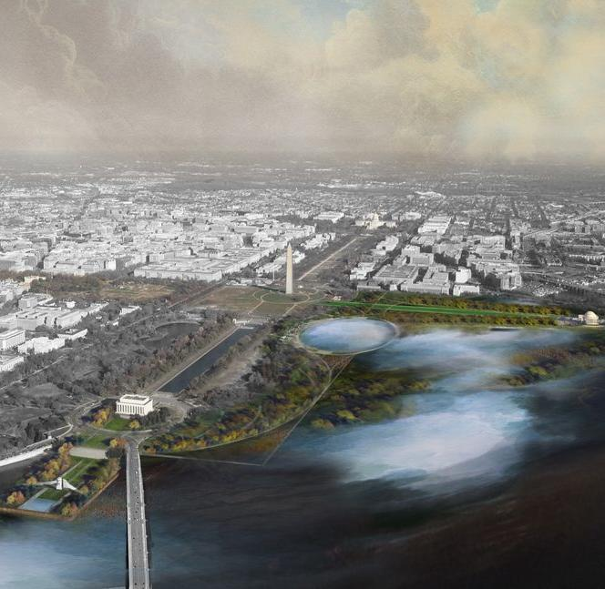
PRESENTATION OUTLINE
The New Political Climate
Insurance Industry Issues
Washington D.C.
States
Industry Engagement

Slide 5
New political climate

Slide 6
Politics always change. Stories never do.
- Stephen King

Slide 7
Perlis, populism and Progressivism
While the Perils remain the same, in the New Era of Risk policymakers look at them with a more critical eye.
These same policymakers are often in one of two political camps growing in size and influence: Populism and Progressivism.
Insurance advocates must develop new strategies to effectively influence these growing political camps on the New Era of Risk.
NATIONAL ASSOCIATION OF MUTUAL INSURANCE COMPANIES

Slide 8
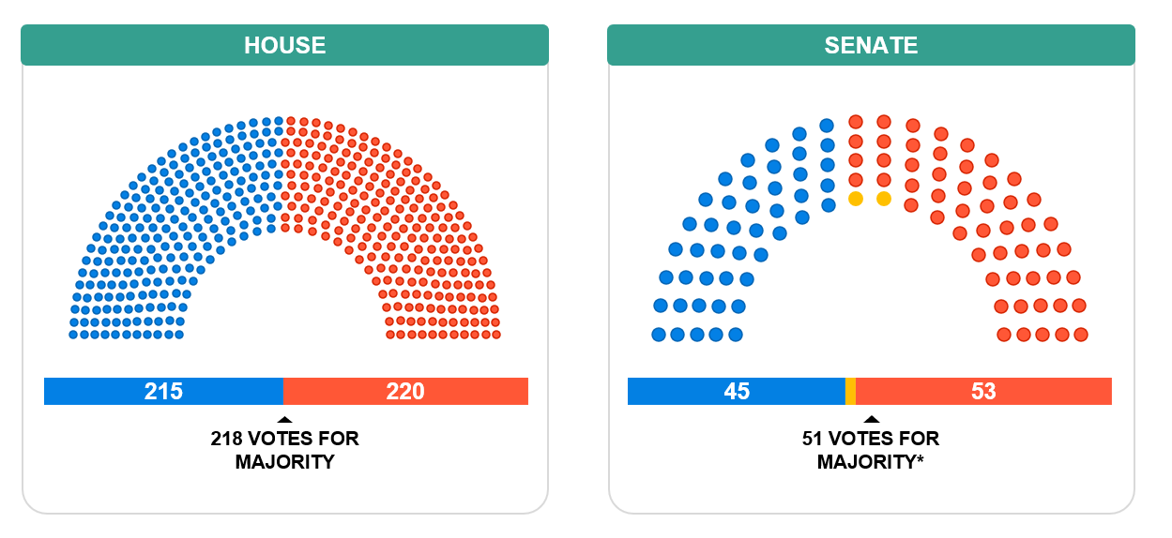
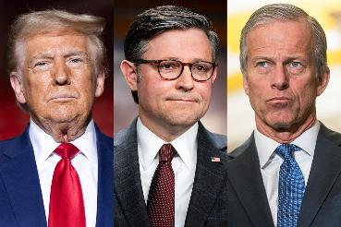
119th congress: GOP Trifecta
Newly elected Senate Majority Leader John Thune (R-SD) & House Speaker Mike Johnson (R-LA)
*Independent Sens Sanders (VT) and King (ME) caucus with Dems
Republicans swept the 2024 elections, delivering Trump full control for his second term – at least for 2 years.
Senate: GOP flips Upper Chamber for a sizeable 53-47 majority; McConnell makes way for Thune
House: Republicans hold onto even slimmer majority; Trump helps Johnson get reelected

Slide 9
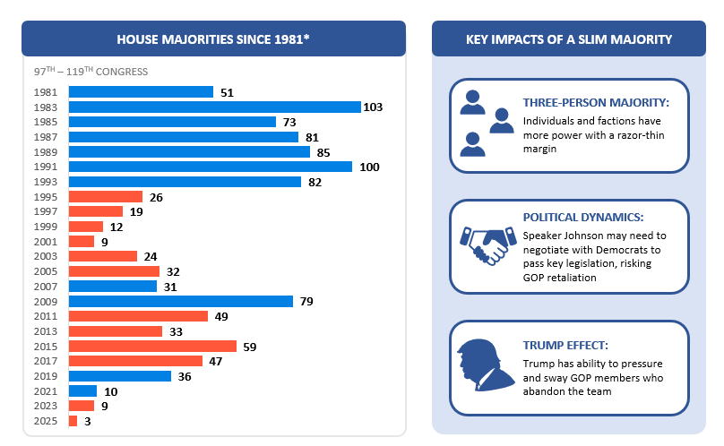
GOP begins with smallest house majority in decades

Slide 10
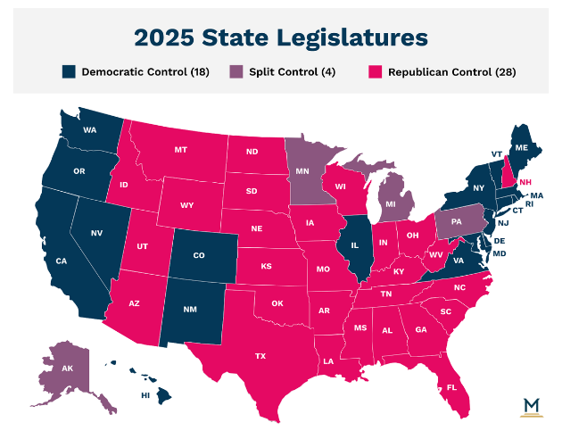
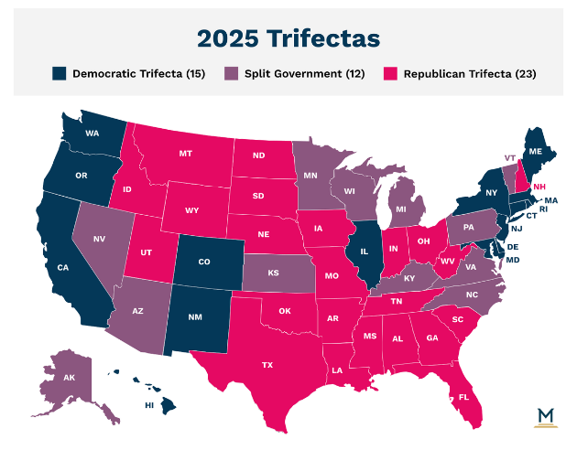
sTATE POLITICAL LANDSCAPE

Slide 11
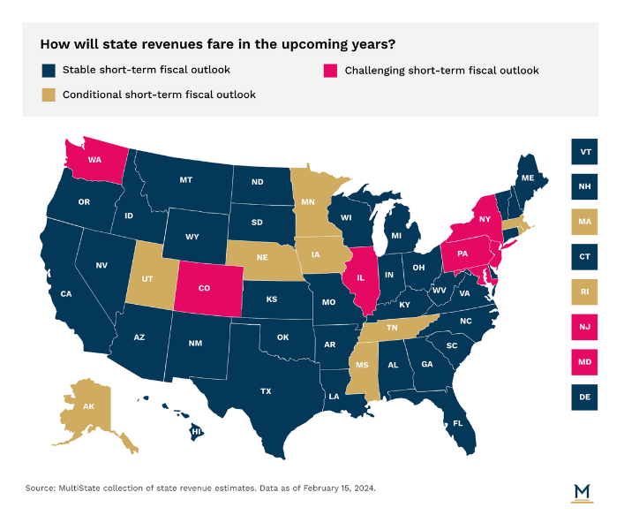
sTATE POLITICAL LANDSCAPE

Slide 12
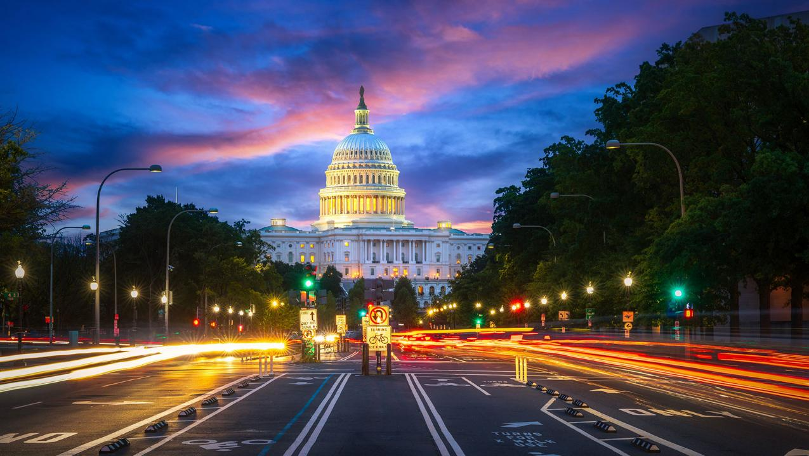
Industry issues in Washington?

Slide 13
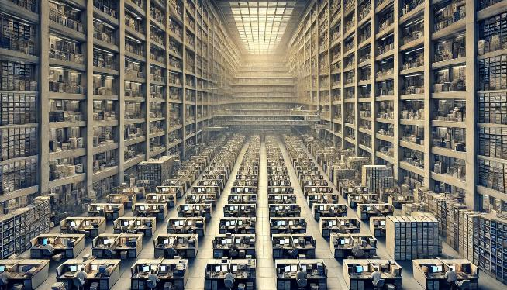
Taming the federal gov’t agency overreach
2024 Federal Register contains 107,262 pages and 3,248 final rules and regulations
Previous high 95,894 pages in 2016
118th Congress enacted 274 laws

Slide 14
DOGE looks to increase federal savings largely by investigating discretionary spending
The Department of Government Efficiency, led by Elon Musk, aims to optimize federal operations through substantial budget cuts and the elimination of unnecessary regulations and federal departments
AGENCY ACCOUNTABILITY
Federal budget cuts
Musk says that he can find $2 trillion in savings by investigating discretionary spending
Proposals have included the elimination of agencies
Regulatory reductions
Looks to end enforcement of regulations deemed beyond agencies’ legal authority
Recommendations for regulatory rollbacks will be submitted directly to the White House for action
Federal workforce reductions
Proposes mass layoffs of federal employees as part of efforts to streamline government operations
TOP PRIORITIES
SECONDARY PRIORITIES
PUBLIC ENGAGEMENT
Enhanced oversight of federal contracts to identify wasteful spending and potential misuse of funds
Talk of soliciting examples of inefficiency and waste through crowdsourcing on social media platforms
RAPID TIMELINE
DOGE is slated to conclude its work by July 4, 2026, coinciding with the US Semiquincentennial
Notes:
Sources:
Holly Honderich, “What we know about Musk's cost-cutting mission,” BBC, December 5, 2025, https://www.bbc.com/news/articles/c23vkd57471o
Sean Michael Newhouse, “Trump’s proposed cuts to the federal workforce could increase dependency on contractors, experts say,” Government Executive, January 14, 2024, https://www.govexec.com/workforce/2025/01/trumps-proposed-cuts-federal-workforcee-could-increase-dependency-contractors-government-relations-attorneys/402190/
“Explainer: How Musk's US government efficiency panel might work,” Reuters, November 14, 2024, https://www.reuters.com/world/us/how-musks-us-government-efficiency-panel-might-work-2024-11-13/

Slide 15
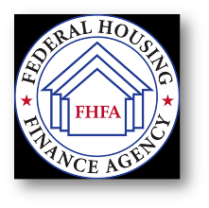
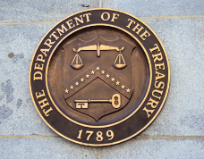
federalization of insurance
HOTTEST PRESENT CHALLENGES - After more active federal agencies & “whole of government” approach under President Biden, NAMIC is working with the Trump administration to reexamine:
Federal Insurance Office (FIO) climate data collection & report
Federal Housing Finance Agency (FHFA) (regulates GSEs) guidance mandating replacement cost policies
Housing and Urban Development (HUD) Disparate Impact litigation
More explicit limitations on scope and authority of Consumer Financial Protection Bureau

Slide 16
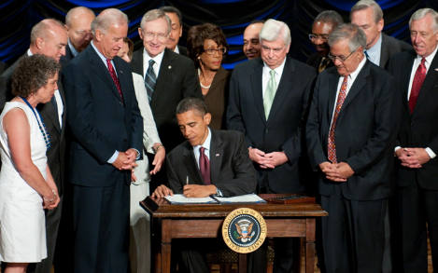
Federal insurance office
FIO was created to “monitor all aspects of the insurance sector” but is prohibited from any regulation of the insurance industry.
Since inception, tension existed between FIO and state-based system.
From 2021-2024, FIO grew and increased efforts, launching unprecedented and unnecessary workstreams under the guise of climate-related financial risk. This was met with vocal opposition by NAMIC, industry, Congress, and state regulators.
Now, abolishing FIO is an open question and NAMIC will continue supporting efforts to reform the office, through legislative or executive action.
President Obama signs the Dodd-Frank Wall Street Reform and Consumer Protection Act into law in 2010 – in response to the financial crisis of 2008.

Slide 17
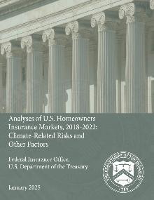
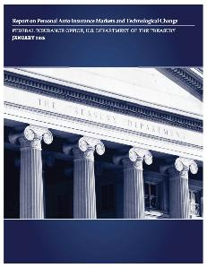
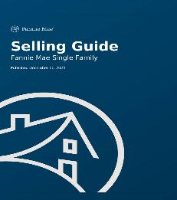
federal final frenzy
In the waning hours of the Biden Administration, federal financial regulators issued dozens of proposals and reports to avoid President Trump’s promised “regulatory freeze.”
Among these were two reports by FIO on the P/C insurance sector, chock full of unsubstantiated, climate-centric “findings” and recommendations for further study and regulation by the states.
Earlier in December, an updated Fannie Mae/Freddie Mac Seller’s Guide was published to include language limiting homeowners’ insurance policy options.

Slide 18
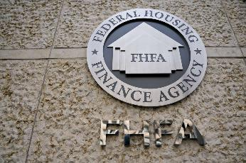
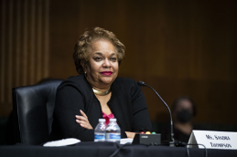
FHFA’s involvement insurance
The Government Sponsored Enterprise (GSEs) changed their guidelines in February to:
Require full-replacement-cost policy for any property with a federally backed mortgage—prohibits ACV policies
Require the replacement cost/valuation be verified annually
Originally June 1 implementation date
Takes away the ability for consumers pick and choose different kinds of coverage to lower their costs
Would cause major disruptions to the housing market, drive up costs for all parties involved, and exacerbate availability and affordability challenges
NAMIC got GSEs to agree to suspend enforcement in 2024, but in December they issued a Selling Guide that now includes the requirement
“’What keeps [me] up at night?’… Affordability and availability of property insurance” – FHFA Director Sandra Thompson

Slide 19
Industry issues in the states?

Slide 20
No man’s life, liberty, or property are safe while the legislature is in session
- Mark Twain

Slide 21
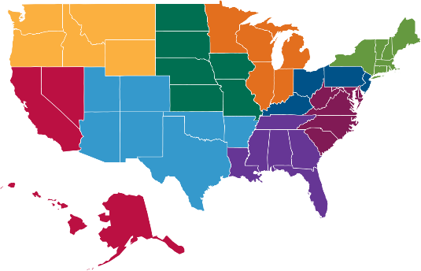
THE NAMIC STATE AFFAIRS TEAM
PAUL MARTIN
Vice President – State Affairs pmartin@namic.org
NAMIC’s 50-state advocacy strategy is executed through regional assignments of our state affairs staff. For more information about an issue or to discuss NAMIC’s position, please contact your regional vice president.
MATT OVERTURF
Assistant Vice President – State Affairs,Ohio Valley moverturf@namic.org
BRANDON VICK
Regional Vice President – Northwest bvick@namic.org
Phillip Arnzen
Regional Vice President – Midwest parnzen@namic.org
CHRISTOPHER NICOLOPOULOS
Senior Regional Vice President – Northeast cnicolopoulos@namic.org
CHRISTIAN RATAJ
Senior Regional Vice President – West crataj@namic.org
BRIAN CHRISTENBERRY
Regional Vice President – Great Lakes bchristenberry@namic.org
GINA ROTUNNO
Regional Vice President – Mid-Atlantic grotunno@namic.org
WARD TISDALE
Regional Vice President – Southwest wtisdale@namic.org
CAITLIN MURRAY
Senior Regional Vice President – Southeast cmurray@namic.org
KATE SALAZAR
State & Policy Affairs Manager ksalazar@namic.org
3601 Vincennes Road | Indianapolis, IN 46268 | 317.875.5250
20 F Street, NW, Suite 510 | Washington, D.C. 20001 | 202.628.1558
www.namic.org

Slide 22
New ERA of risk
The property/casualty insurance industry continues to navigate an unprecedented period of disruption with a confluence of factors:
Increasing frequency and severity of extreme weather and natural disasters
Economic and inflationary pressure
Exploitation of the egal system
Reinsurance capacity

Slide 23
Seeking solutions IN A “NEW ERA OF RISK”
Bend the curve via package of mitigation and resiliency steps – grants, savings accounts, building codes to land use…
Retain discipline with fundamentals like risk-based pricing, consumer choice, and market-based competition
Put guardrails around litigation and take steps to combat legal system abuse
Notes:
Ultimately, components of solutions must include
Respecting insurance fundamentals,
Reducing risk and lawsuits, and
Bringing down costs.

Slide 24
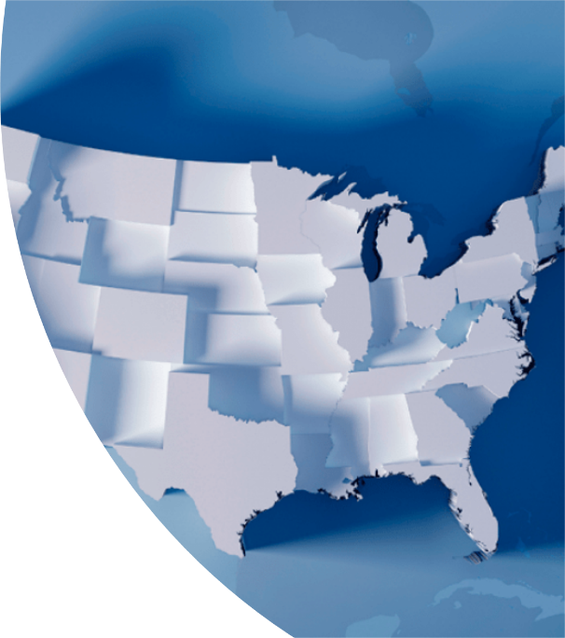
worrisome themes, bad ideas aplenty
Increased scrutiny, oversight and regulation for the business of insurance
Requests for policy recommendations to address “climate crisis” through solutions on Capitol Hill and Statehouses
Industry in the crosshairs
Ignoring state efforts and existing statutes
Ultimately consumers are hurt the most
Proposed overreach and political grandstanding

Slide 25
Issues in the states
Availability/Affordability of Insurance
Property insurance
Hard market
Focus on mitigation/resilience
NCOIL Strengthen Homes model
Auto Insurance
Risk based pricing
AI
Artificial intelligence
“High-risk” AI—focuses on developers and users of AI for consequential decision making, including insurance
NAMIC seeks ‘exemption’ for insurance
Virginia, Colorado, Connecticut, Nebraska, New York
Risk Based Pricing
Pennsylvania (HB 657) , New Mexico, New Jersey, Washington, Illinois, Georgia, Maryland, Oregon
Online Insurance Verification
Pennsylvania (HB 710), Kentucky, New York, Indiana

Slide 26
Issues in the states
Wildfire
Residual markets
State provided reinsurance (“CAT Funds”)
State funding for mitigation
Aerial Images
DOI Bulletins: Pennsylvania (Notice 2024-06), Massachusetts, New Hampshire, Maine
NCOIL draft model (currently) would require:
Property owners receive date-stamped images of their property;
Specific disclosures or what conditions were deficient;
An appeals process;
A time period in which to make changes; and
A form of guaranteed issuance of coverage if changes were made.

Slide 27
Issues in the states
Third-Party Litigation Funding
~20 states considering TPLF disclosure legislation
Utility Liability
Provides liability immunity for utility companies
Started in the west, slowly shifting east
Arizona, Hawaii, New Mexico, Wyoming, Montana, North Dakota, Kansas, Idaho, Oregon
Tort Reform Efforts
Georgia, South Carolina, Missouri, Iowa
Assignment of Benefits Prohibition
Virginia, Connecticut, Oklahoma, Georgia

Slide 28
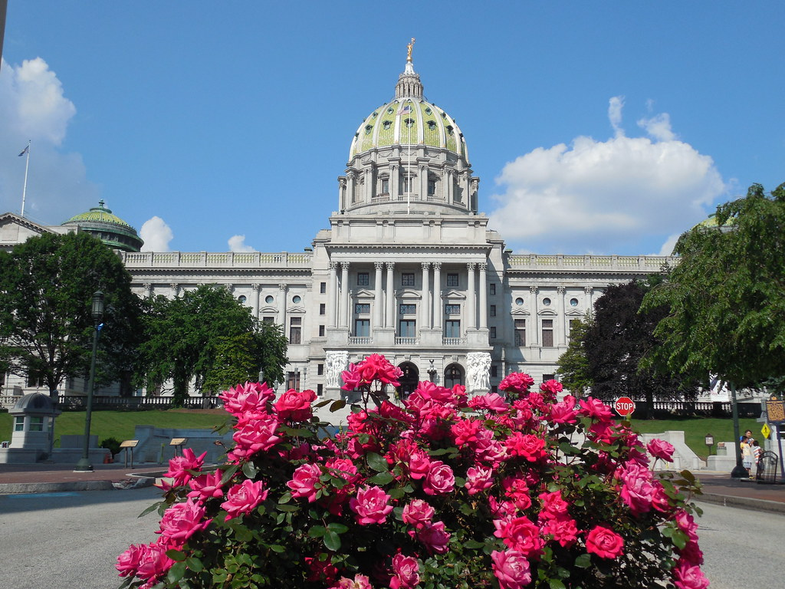
Pennsylvania
This Photo by Unknown Author is licensed under CC BY-NC-ND

Slide 29
sTATE POLITICAL LANDSCAPE

Slide 30
sTATE POLITICAL LANDSCAPE

Slide 31
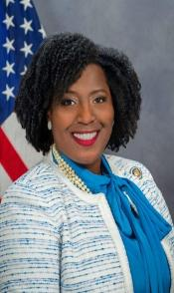
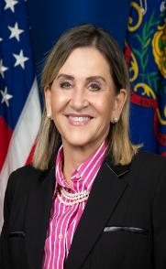
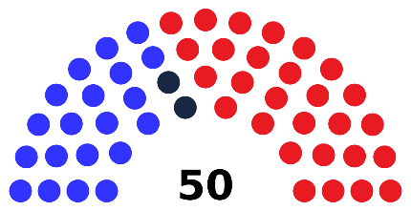
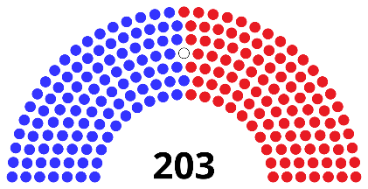
Pennsylvania: divided government
Senate
House
Speaker Joanna McClinton (D-Philadelphia)
President Pro Tempore Kim Ward (R-Westmoreland)
Status Quo
Senate: Remains 28-22 Republican majority
House: Remains 102-101 Democrat majority

Slide 32
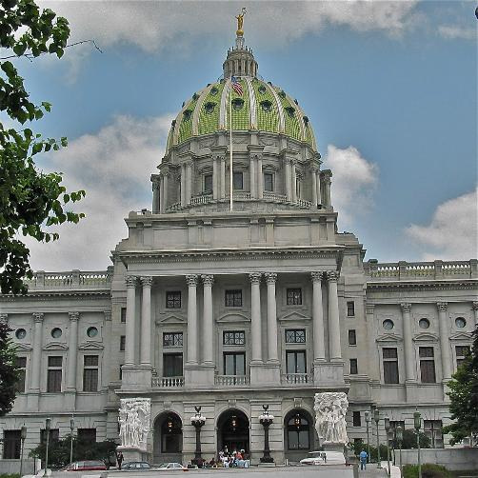
Pennsylvania
Insurance Department
Unknown Data Proposed Regulation
3rd draft, comments due March 14
P&C Quarterly Meetings
April 18th
Legislative
State Budget
Stacking
Renewals
Online Insurance Verification
Towing
This Photo by Unknown Author is licensed under CC BY-NC-ND

Slide 33
Industry engagement

Slide 34
there is only one way to insure against uncertainty:
Insurers must be engaged in shaping the legislative and regulatory landscape
“If insurance is your profession
then politics is your business.”

Slide 35
Your voice with lawmakers
Every day, elected officials at all levels make decisions that impact your company and policyholders
A strong PAC helps to educate lawmakers and make sure your voice is heard
100% of contributions go straight to candidates.
Leverage giving through member relationships
Congressional Contact Program
Strategic Giving
Supports state and federal candidates from both sides of the aisle

Slide 36
THANK YOU
Matt Overturf, AVP State Affairs, Ohio Valley
moverturf@namic.org | 937.935.0432

