Slide 1
PAMIC
Financial Management Seminar
Sept 18, 2025
Diana Sherman
Office of Corporate & Financial Regulation

Slide 2
Office of Corporate and Financial Regulation Updates
  Developing staff to meet the growing needs of Pennsylvania's insurers
  Majority of staff maintain professional designations.
  All staff receive over 20 CPE training credits annually.
  Filled vacant analysis positions:
    5 Managers & 20 Analysts
  New Licensing Chief – Steve Yerger
    Staff of 5 supporting over 2,000 entities and 30 license types
  New Examination Director – Rob Woronko
    Five new Managers trained in-house

Slide 3
Financial Regulation –
Industry Wide Developing Risks
Insurtech
Federal & International Regulatory Developments
Private Equity Firm Relationships with Insurers
Inflation & Tariffs

Slide 4
Financial Regulation –
Risk Concerns Affecting P&C Insurers
CAT/Climate & CAT Reinsurance Market
Cybersecurity Insurance
Casualty Catastrophe
Insurer Investments:
  Inflation & Interest Rate Impacts on Investment Markets
  Changing Investment Strategies & Profiles
  Regulatory Guidelines
Emerging Risks
  Private Flood
  ESG

Slide 5
Investment & Capital Market Trends
Industry wide - invested assets
Foreign Investments
Emerging Markets Investments
RMBS
PE Owned Insurer Investment

Slide 6
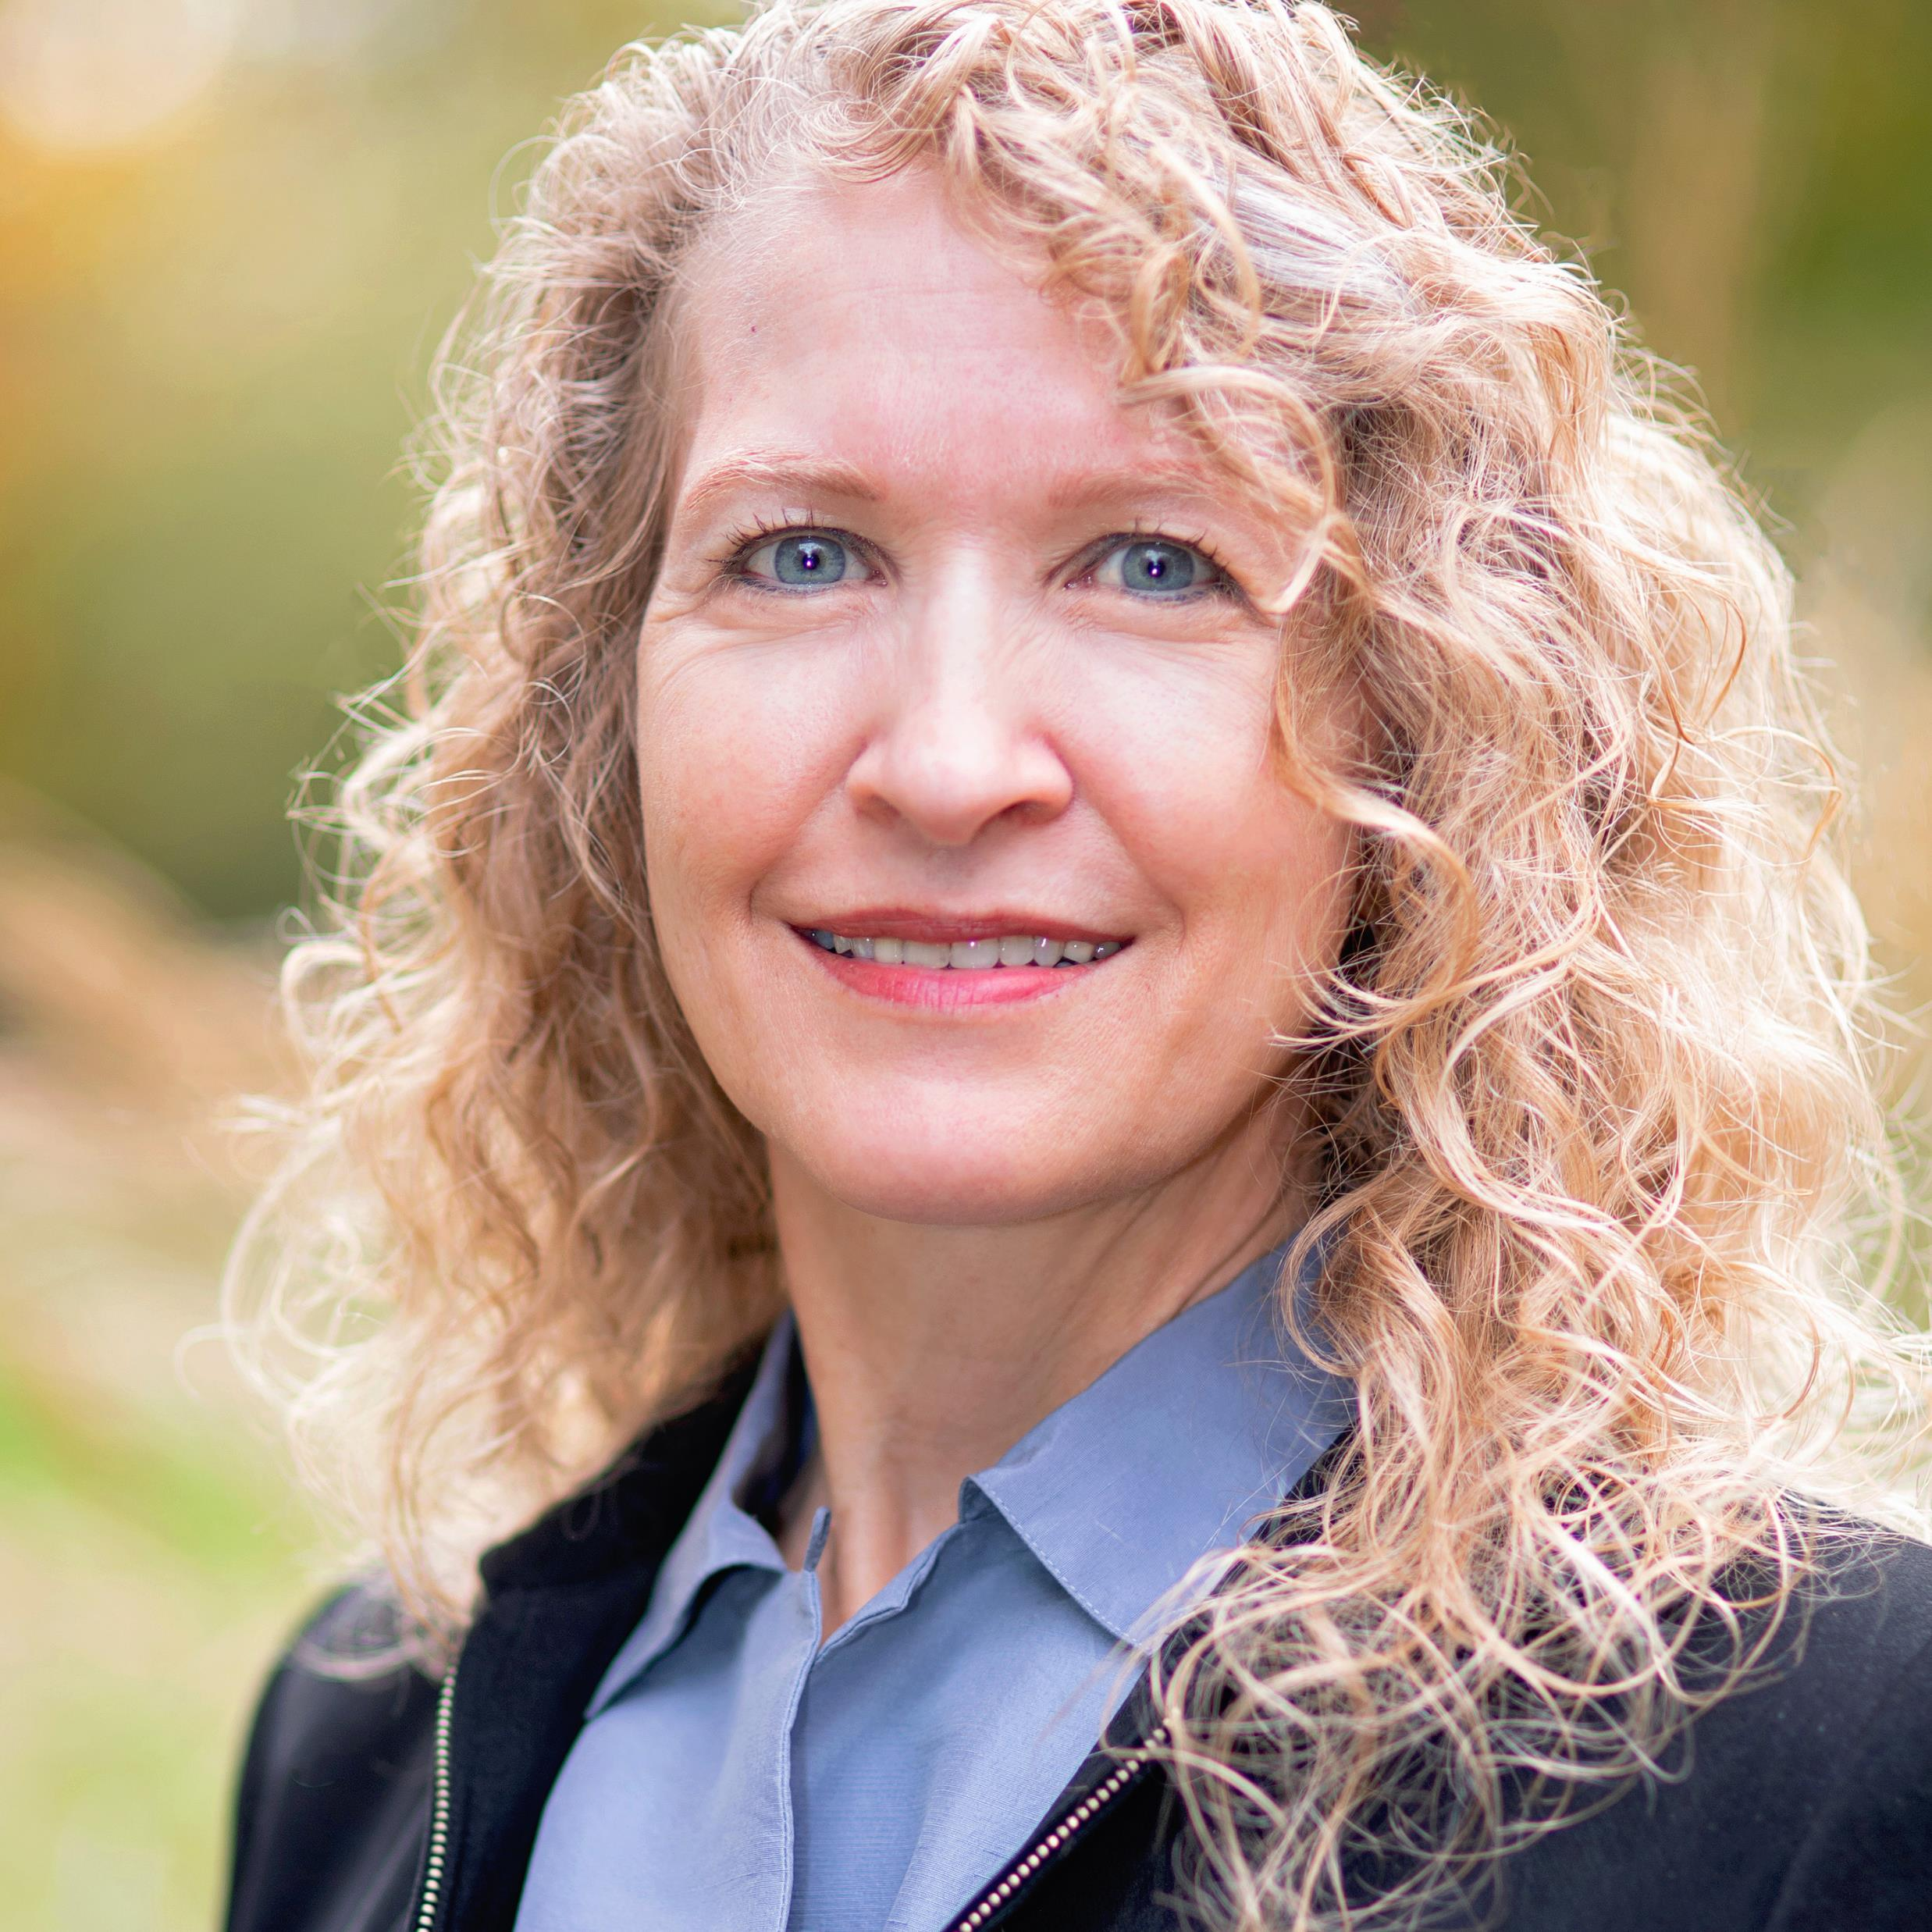
DIANA SHERMAN
PENNSYLVANIA DEPUTY INSURANCE COMMISSIONER
OFFICE OF CORPORATE & FINANCIAL REGULATION
Questions or Interest in discussing a contemplated financial transaction, structure change, accounting treatment or reporting dilemma?
Diana is Pennsylvania’s Deputy Insurance Commissioner for the Office of Corporate and Financial Regulation (“OCFR”). She joined the Pennsylvania Department in 2022, from the New Jersey Department where she held a similar role.
Prior to insurance regulation, Diana’s career included public accounting and insurance industry positions that concentrated in directing external and internal audit functions. She has coordinated on the Group Wide Supervision of multiple Internationally Active Insurer Groups, hosts international supervisory colleges, and serves on numerous National Association of Insurance Commissioners (“NAIC”) and International Association of Insurance Supervisors (“IAIS”) committees.
OCFR oversees licensing, solvency, compliance, and regulated transactions including M&A, Hold Co, and affiliate transactions of two thousand risk bearing entities including 220 domestics authorized to transact in the Commonwealth. Diana collaborates on the drafting of law, regulatory standards and practices for insurers of all types, structures, and scale with focus on capital adequacy, ERM & governance; portfolio, and emerging risks including climate, cyber, PE, and AI.
PROFESSIONAL
AFFILIATIONS
- Certified Public Accountant
Certified Information Systems Auditor
Certified Information Technology Professional
Certified Fraud Examiner
Committee Member: Supervisory Forum and the Standards Assessment Working Group of the- International Association of Insurance Supervisors
- Chair, NAIC Chief Financial Regulators Forum
- Vice Chair, NAIC / AICPA Working Group
- National Association of Corporate Directors
- American Institute - Certified Public Accountants
- Information Systems Audit & Control Association
- Association of Certified Fraud Examiners
Email: DiSherman@PA.gov

Slide 7
PAMIC Financial Management Seminar
PID P&C Rate Review
September 18, 2025
www.insurance.pa.gov
The Pennsylvania Insurance Department is a regulatory agency tasked with the oversight and enforcement of the insurance laws of the Commonwealth of Pennsylvania. The Department does not render legal opinions or legal advice to third parties and nothing in this presentation should be considered as such. The Department also does not offer official statements of policy and this presentation should not be so construed. This presentation is offered merely as guidance to the specific questions raised herein as a courtesy to the viewer. Should you have questions regarding the content of this presentation it is recommended that you seek the advice of legal counsel. This presentation is not to be published or circulated without the express written consent of the Department.

Slide 8
Rates Cannot Be Excessive, Inadequate or Unfairly Discriminatory
40 P.S. §§ 710-7(b), 910-39, 1183(d), 1223(a)(2); 77 P.S. § 1035.4(a)(1)
“No rate shall be held to be unfairly discriminatory unless, allowing for practical limitations, it clearly fails to reflect with reasonable accuracy the differences in expected losses and expenses.” – 40 P.S. § 1183(d)

Slide 9
C.A.S. Statement of Principles
Property and Casualty Insurance Ratemaking
“I. DEFINITIONS
Ratemaking is the process of establishing rates used in insurance or other risk transfer mechanisms. This process involves a number of considerations including marketing goals, competition and legal restrictions to the extent they affect the estimation of future costs associated with the transfer of risk.”*
*Emphasis added by PID

Slide 10
C.A.S. Statement of Principles
Property and Casualty Insurance Ratemaking
“Principle 1: A rate is an estimate of the expected value of future costs.
Ratemaking should provide for all costs so that the insurance system is financially sound.”

Slide 11
C.A.S. Statement of Principles
Property and Casualty Insurance Ratemaking
“Principle 2: A rate provides for all costs associated with the transfer of risk.
Ratemaking should provide for the costs of an individual risk transfer so that equity among insureds is maintained. When the experience of an individual risk does not provide a credible basis for estimating these costs, it is appropriate to consider the aggregate experience of similar risks. A rate estimated from such experience is an estimate of the costs of the risk transfer for each individual in the class.”
.

Slide 12
C.A.S. Statement of Principles
Property and Casualty Insurance Ratemaking
“Principle 3: A rate provides for the costs associated with an individual risk transfer.“*
“Ratemaking produces cost estimates that are actuarially sound if the estimation is based on Principles 1, 2, and 3. Such rates comply with four criteria commonly used by actuaries: reasonable, not excessive, not inadequate, and not unfairly discriminatory.”
*Emphasis added by PID

Slide 13
C.A.S. Statement of Principles
Property and Casualty Insurance Ratemaking
“Principle 4: A rate is reasonable and not excessive, inadequate, or unfairly discriminatory if it is an actuarially sound estimate of the expected value of all future costs associated with an individual risk transfer.”*
*Emphasis added by PID

Slide 14
C.A.S. Statement of Principles
Property and Casualty Insurance Ratemaking
“III. CONSIDERATIONS”
“Homogeneity—Ratemaking accuracy often is improved by subdividing experience into groups exhibiting similar characteristics. For a heterogeneous product, consideration should be given to segregating the experience into more homogeneous groupings. Additionally, subdividing or combining the data so as to minimize the distorting effects of operational or procedural changes should be fully explored.”

Slide 15
C.A.S. Statement of Principles
Property and Casualty Insurance Ratemaking
“III. CONSIDERATIONS”
“Credibility—Credibility is a measure of the predictive value that the actuary attaches to a particular body of data. Credibility is increased by making groupings more homogeneous or by increasing the size of the group analyzed. A group should be large enough to be statistically reliable. Obtaining homogeneous groupings requires refinement and partitioning of the data. There is a point at which partitioning divides data into groups too small to provide credible
patterns. Each situation requires balancing homogeneity and the volume of data. “

Slide 16
C.A.S. Statement of Principles
Property and Casualty Insurance Ratemaking
“III. CONSIDERATIONS”
“Policy Provisions—Consideration should be given to the effect of salvage and subrogation, coinsurance, coverage limits, deductibles, coordination of benefits, second injury
fund recoveries and other policy provisions.”
“Mix of Business—Consideration should be given to distributional changes in deductibles, coverage limitations or type of risks that may affect the frequency or severity of claims.”

Slide 17
C.A.S. Statement of Principles
Property and Casualty Insurance Ratemaking
“IV. CONCLUSION”
“The actuary, by applying the ratemaking principles in this Statement, will derive an estimation of the future costs associated with the transfer of risk. Other business considerations are also a part of ratemaking. By interacting with professionals from various fields including underwriting, marketing, law, claims, and finance, the actuary has a key role in the ratemaking process.”

Slide 18
Rate Filings
Calendar/Accident/Policy Years and Weights
Premium and Loss Trend (Especially Prospective)
Leveraged Effect of Inflation
Full Credibility Standard
Complement to Credibility
Cat and Large Loss Loads
Reinsurance
Expenses
Return on Equity / Surplus
Data Underlying Predictive Models
Deviations from Indications
Individual Policyholder Impacts

Slide 19

QUESTIONS
AND
DISCUSSION

