Slide 1
Reinsurance 101
Cardine Zalenski
April 2025

Slide 2
What is Reinsurance?
Insurance for Insurance Companies
An insurance company, called the cedent or ceding company, passes along, in exchange for a share of the premium, some or all of the risk it assumes under its insurance policies to another insurance company, known as the reinsurer.
The underlying policyholder generally has no rights under the reinsurance contract.
Reinsurance of reinsurance is known as “retrocession.”

Slide 3
Why Purchase Reinsurance?
UNDERWROTE
Increase Capacity
Premium
Large Line
Spread Risk & Stabilize Loss Experience
Protect Policyholder Surplus
Excess Verdict / Extracontractual (Bad Faith)
Gain Underwriting & Claims Experience
Line of Business
New States/Locations
Obtain Relief from Catastrophic Storm
Hail and Wind
Hurricane
COMPANY
SOVENCY
INSUFFICIENTLY
EXPIRATION
YEARINSURER
SMOOTHING
INSURANCE
QUOTA
BROKERED
FAC
UNDERWRITING
PERIODSURPLUS
RETAIN
ACTUARIAL
BILLION
AGREEMENT
PROTECTION
RELIEF
BILLION
PROPERTY
RELIEF
EXCESS
CLAIMPROPORTIONAL
PORTFOLIO
RATA
REINSURANCE
WINDSTORM
MILLION
MILLION
UNUSUAL
BUSINESS BASIC
LOSS
TREADY
RISKEXPERTISE
REINSURANCE
COVERAGE
ATTACHING
DATE
NUMBER
CAPITAL
EXCESS
REVIEW
RETENTION
PREMIUM
JURISDICTIONS
LOCAL
STATED
CAPITAL
UNDERLYING
STATED
INCUR
INSURE
CONTRACT
POLICY FRONTING
Notes:
Say we wanted to start our own insurance company. As investors, we would need access to capital and financial stability as we sought to grow our book. For us, reinsurance would be a vital tool for us to start and grow our business. At the beginning, we would likely carry low retentions and reinsure most of the policies. Then, as time went on and assuming we were becoming successful, we would retain more of the risk and change our reinsurance relationship accordingly. Point to me made: Relationship is dynamic and changes over time.

Slide 4
Why Should I (a Claims Person) Care About Reinsurance?!
Your company’s exposure may be limited if reinsurance
You may be contractually obligated to report to the reinsurer or face
Risks of late notice
You can take advance of reinsurer’s expertise
Notes:
Say we wanted to start our own insurance company. As investors, we would need access to capital and financial stability as we sought to grow our book. For us, reinsurance would be a vital tool for us to start and grow our business. At the beginning, we would likely carry low retentions and reinsure most of the policies. Then, as time went on and assuming we were becoming successful, we would retain more of the risk and change our reinsurance relationship accordingly. Point to me made: Relationship is dynamic and changes over time.

Slide 5
What Does a Reinsurance Claims Person Do?
Reserving:
Ceded Reserve
ACR/AER
Notes:
The most important thing a claims person does is protect the company’s assets. There are two types of reserves. A ceded reserve is….. An ACR/ AER is (given an example or two of when you would post an ACR)

Slide 6
Importance of Timely, Accurate, Consistent Reserving
“
It’s clearly difficult for an insurer to put a figure on the ultimate cost of all … reported and unreported events.
But the ability to do so with reasonable accuracy is vital.
Otherwise, the insurer’s managers won’t know what its actual loss costs are and how these compare to the premiums being charged.
Notes:
Mr. Buffet recognizes the importance of reserving

Slide 7
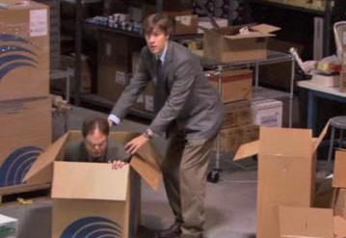
What Does A Reinsurance Claims Person Do?
Individual Files
Review and evaluate facts, coverage, and legal issues
Agree with cedant’s reserve or post ACR or AER
Suggest alternate defense counsel or experts
Explore settlement strategy
Consult on overall claims handling strategy, including subrogation
Claim Reviews
Can be remote or on site
Analyze ceded and unreported claims
Evaluate overall effectiveness of client’s operation
Claims investigation
Reserving
Expense Control, etc.
Wrap-up session to discuss findings
Claim review letter memorializing visit and wrap up discussions.
Other Activities
Training Sessions and Presentations (like this one!)
Articles and Blogs
The Wrong Way to Review a Claim File

Slide 8
Forms of Reinsurance
Treaty Reinsurance
A reinsurance contract covering cedent’s “whole account,” or an entire line or class of business written by the cedent.
The reinsurer has no opportunity to review individual risks and is automatically bound for its share of risks written by cedent falling within terms of the treaty.
Treaties are detailed, multi-page contracts.
Frequently placed with multiple reinsurers who accept shares of the risk.

Slide 9
Forms of Reinsurance
Facultative Reinsurance
The ceding company offers to share an individual risk with the reinsurer.
The reinsurer underwrites (evaluates) the individual risk and decides whether to accept or reject.
Facultative “certificates” are typically pre-printed two-page forms with abbreviated standard provisions.
Frequently “follows form” to the underlying policy (subject to same terms and conditions).
May inure to the benefit of treaty reinsurance.

Slide 10
Forms of Reinsurance
Facultative Cover May Be Used For Different Purposes, Such As:
Writing classes of business excluded from a treaty
protect treaty from losses
gain additional capacity
stabilize loss experience
mitigate effect of large losses
reinsure risks too “exotic” for treaty coverage

Slide 11
How can reinsurance be structured?
Two Basic Structures
1
Pro Rata a/k/a Quota Share
2
Excess of Loss

Slide 12
Pro Rata (Quota Share) Reinsurance
Reinsurance in which the assuming company provides coverage for a percentage of the risk or risks reinsured, often from the ground up.
Premium is a similar portion of premium paid to the cedent by its insured, subject to possible ceding commission.

Slide 13
Pro Rata (Quota Share)
Insurer (Cedent)
50% Pro Rata Reinsurer
Ins. Reins.
$10M
$5M
$5M

Slide 14
Excess of Loss
Reinsurance that only applies to that portion of the cedent’s loss in excess of a particular sum
Premium based on risk determined by actuarial considerations - not pro-rata

Slide 15
Excess of Loss
Insurer (Cedent)
Excess of Loss Reins. $5M x 5M
Ins. Reins.
$10M
$5M

Slide 16
Excess of Loss Illustration
$25M
3nd Excess of Loss $15,000,000 xs $10,000,000
Fixed retention
Different attachment points
Layers can be divided among several reinsurers
Greater number of participants, greater chance for payment delay
Spreading of risk = increased capacity
$10M
2nd Excess of Loss $5,000,000 xs $5,000,000
$5M
1st Excess of Loss $3,000,000 xs $2,000,000
$2M
Company Retention
$2,000,000

Slide 17
Key Reinsurance Doctrines
Utmost Good Faith
Follow the Fortunes/Settlements

Slide 18
Duty of Utmost Good Faith
A heightened and reciprocal duty of care owed by and between a cedent and its reinsurer based upon the reliance and dependence between the parties given the nature of the relationship.
Defined as the cornerstone of the reinsurance relationship and often expressed as:
the most abundant good faith
absolute and perfect candor and honesty
the absence of any concealment or deception, however slight
Duty of utmost good faith is generally considered to be implicit in all reinsurance relationships.

Slide 19
Duty of Utmost Good Faith
Duty of utmost good faith is generally considered to be implicit in all reinsurance relationships.
Applies to all aspects of the relationship including contract formation and renewal, underwriting the cedent’s business, claims handling, payment of claims, and post-settlement allocation of claim payments.
Determination of compliance is necessarily fact specific but usually involves an analysis of whether one party’s conduct is grossly negligent or reckless, if not intentional, and may require expert testimony.

Slide 20
Follow the Fortunes/Follow the Settlements
Often considered a hallmark of the reinsurance relationship.
Although many courts and commentators use follow the fortunes and follow the settlements interchangeably, there is a difference:
“Follow the Fortunes”
“Follow the Settlements”
Reinsurer must share in the underwriting fortunes or fate of the particular business, even if there are bad results.
Reinsurer is bound by the cedent’s decision-making in the handling and settlement of claims (even those only “arguably” covered), provided that the cedent acted in a businesslike manner and its decision to pay was reasonable and in good faith.

Slide 21
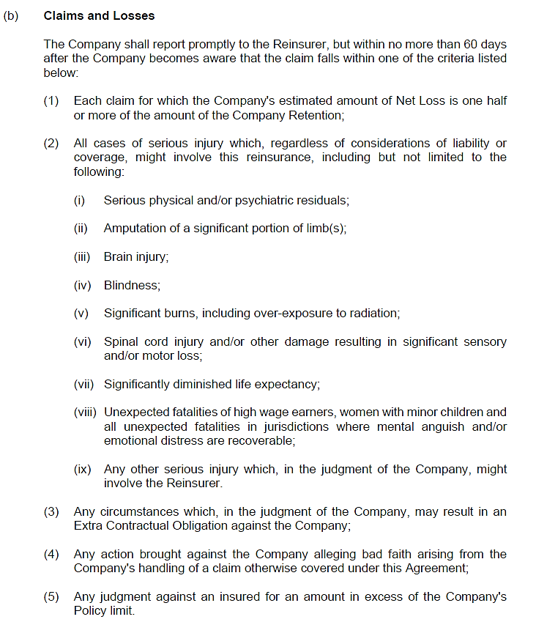
Relationship Safeguards
Most reinsurer/ceding company relationships go smoothly, but a very small number don’t
When disagreements arise, most are handled during normal business course
Contractual Language
Reporting Obligations (Injury and Severity)
Right to Participate / Associate
Cancellation
Cut Off
Run Off
Notes:
Injury criteria reporting / Financial
Right to associate examples: (1) PRA CP; (2) Granada ECO case
Most cancellations are run off – reporting obligations continue; need for good relationship. KGS: Yesterday’s client could be tomorrow’s client.

Slide 22
Access to Records
The Company shall place at the disposal of the Reinsurer and the Reinsurer shall have the right to inspect, through its authorized representatives, at all reasonable times during the currency of this Agreement and thereafter, the books, records and papers of the Company pertaining to the reinsurance provided hereunder and all claims made in connection therewith. If the Company demonstrates to the Reinsurer that, as a matter of law in the relevant jurisdiction, disclosure to the Reinsurer of the Company's attorney client and/or work product documents is likely to jeopardize the privilege attached to such records, the Company and the Reinsurer agree that they will take all steps necessary to preserve the privilege, so that the Reinsurer's access to such records remains unencumbered. Provision of any documents or information to the Reinsurers under this clause shall not constitute waiver by the Company of any applicable privileges. In addition, when arbitration or legal proceedings are pending between the parties hereto, this right of inspection shall only be exercised in accordance with the procedures of such arbitration or legal proceedings.

Slide 23
Arbitration
Each company appoints its own arbitrator, with both companies agreeing on a “neutral” who will decide case
Agreement details specifics
Limited discovery performed
Written discovery
Document exchange
Depositions
Hearing
Testimony from each side
Decision
Notes:
Glenn will in all probability chime in here.

Slide 24
Advantages of Arbitration
Efficient
Cost effective
Dispute resolved “behind the scenes”
Panel hearing case familiar with unique issues arising in reinsurance cases
Results generally acceptable to both parties
Trend to “split the baby with the bathwater”

Slide 25
Claims Example
Notes:
I would walk through one of your claims (Maybe a Merchants claim). What happened, you were given late notice, ultimately we paid (counsel said 85 percent chance of winning on appeal)

Slide 26
Reinsurance Trivia
A
Kölnishe Rückversicherungs –Gesellschaf
Who was the First Independent Reinsurance Company in 1846?
B
Cologne Re
C
Spectator Re
D
Hamburg Re
Notes:
Answer A

Slide 27
Reinsurance Trivia
A
1843
What year was Gen Re founded?
B
1776
C
1312
D
1921
Notes:
Answer D. Gen Re is 104 years old

Slide 28
Reinsurance Trivia
A
43
As of 2024 how many reinsurance companies are there in the United States?
B
1,232
C
601
D
209
Notes:
Answer D

Slide 29
Thank you
Cardine Zalenski
cardine.zalenski@genre.com
203 328 6315

